Slide 1
Infrastructure Network Connection
By Aditya gupta

Slide 2
What is infrastructure NEtwork connection
Infrastructure network is that in which devices communicate with each other by first going through an Access Point (AP).
In infrastructure network, wireless devices can communicate with each other or can communicate with a wired network.
We can connect n number of devices without compromising on the output of the network.

Slide 3

INTERNET
SNRC 2
SNRC 1
cust
cust
cust
cust
AR
cust
AR
Inter Network Connection
Allocated
Inter Network Connection
Allocated
IGR
cust
cust
AR
BR
BR
AR
cust
BACKBONE LINK
cust
cust
AR
cust
AR
cust
cust
cust
INFRASTRUCTURE NETWORK

Slide 4
Access Routers (AR)
The main aim of these routers is to collect the data and send the data to user.
Customers are allocated to different access router whichever is the nearest and best possible for their location.
These are for small location.

Slide 5
BACKBONE ROUTERS (BR)
These are the routers which do not have direct contact with the customers but they are in contact with different Access Routers.
The chain of connected BR’s is known as Core Backbone Network (CBB).
As different AR are connected to single BR so it covers a big location.

Slide 6
International Gateway Router (Igr)
It is that router which all BR uses in order to send data to each other.
We can call it as a pathway connecting two BR.
It is a generic gateway which is maintained by IEEE.

Slide 7
Abbreviations and explaination
Cust -----> Customer
AR -------> Access Router
BR -------> Backbone Router
IGR -----> International Gateway Router
SNRC ---> Single Node Routing Complex
So here Customers are allocated to different Access Routers depending upon their location and best suitability which when send or receive data from to and from customers. Then these Access Routers send this information to their respective Backbone Router. Thus these Backbone router transfer their information to International Gateway Router and thus this International Gateway Router transfers it to the respective Backbone router and thus to Access Router and to the respective customer.

Slide 8
Two types of infrastructure network
LAG
Non LAG

Slide 9
NON - LAG
A connection between to entities whether its between two port or two switches etc.
Each link is independent here and have different recognition of its own.

Slide 10
LAG
It is the connection made up of physical connections.
All connections have different recognition and one LAG id as well.
it helps in increasing efficiency and output of the networks.
LAG
(Link Aggregation Group)

Slide 11
Advantages of using infrastructure network connection
Infrastructure network provides us the centralised security.
It is more scalable as through many access routers we can increase our reach.
It has better operating range.

Slide 12
Components in infrastructure network
Switches.
Routers
Firewalls.
Servers.
Load Balancer.
Storage Area Network (SAN)
DNS

Slide 13
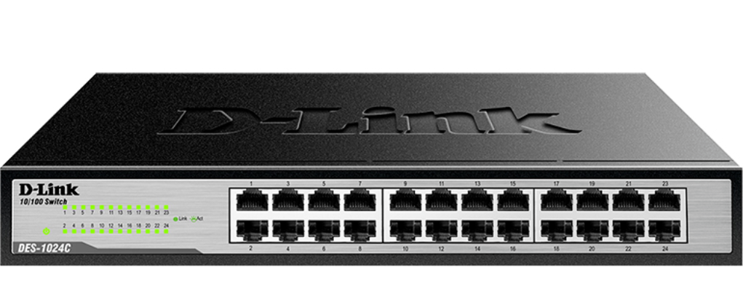
Switches
A network switch is the device that provides connectivity between network devices on a Local Area Network (LAN).
A switch contains several ports that physically connect to other network devices – including other switches, routers and servers.

Slide 14
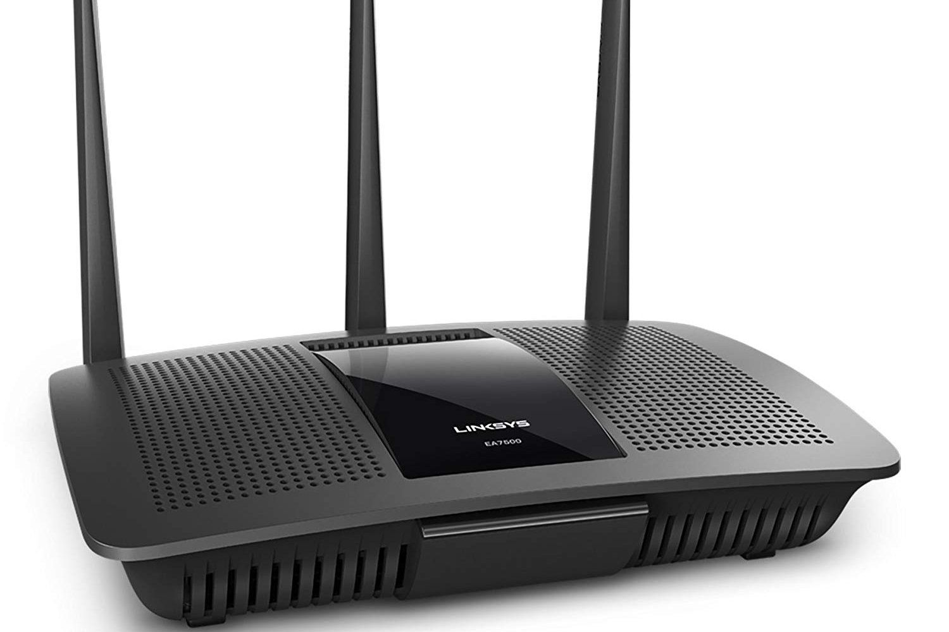
Routers
Routers move packets between networks.
Routing allows devices separated on different LANs to talk to each other by determining the next “hop” that will allow the network packet to eventually get to its destination.

Slide 15
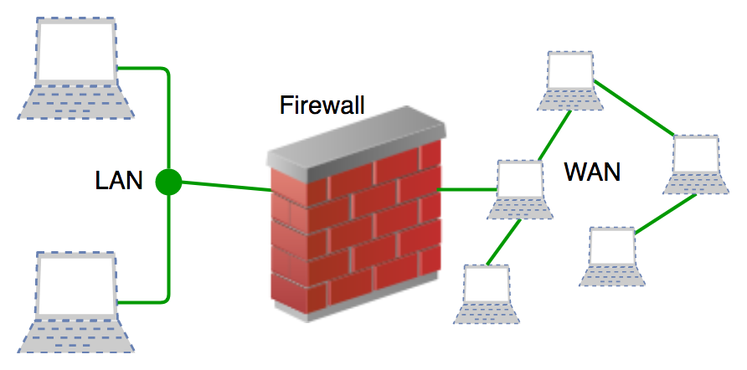
Firewalls
Firewalls are security devices at the edge of the network. The firewall can be thought of as the guardian or gatekeeper.
A set of rules defines what types of network traffic will be allowed through the firewall and what will be blocked.

Slide 16
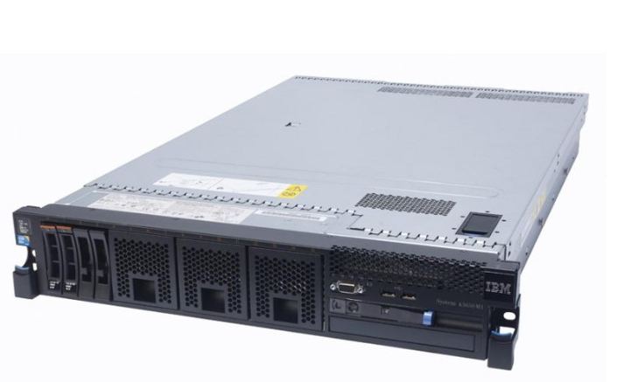
Servers
A network server is simply another computer, but usually larger in terms of resources than what most people think of.
A server allows multiple users to access and share its resources.

Slide 17
LOAD BALANCER
A load balancer is a device that acts as a reverse proxy and distributes network or application traffic across a number of servers.
Load balancers are used to increase capacity (concurrent users) and reliability of applications.
They improve the overall performance of applications by decreasing the burden on servers associated with managing and maintaining application and network sessions, as well as by performing application-specific tasks.

Slide 18
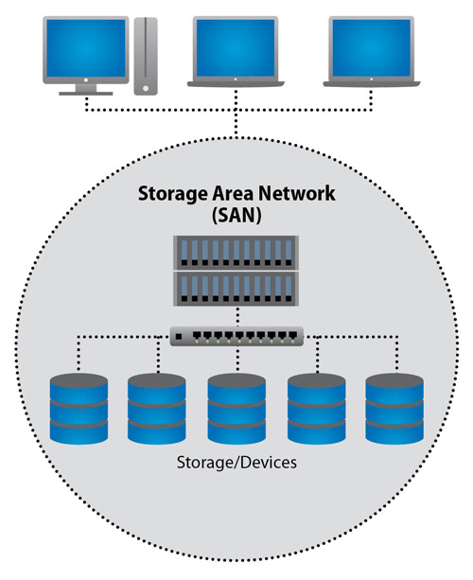
Storage area network (SAN)
A Storage Area Network (SAN) is a specialized, high-speed network that provides block-level network access to storage.
A SAN presents storage devices to a host such that the storage appears to be locally attached.

Slide 19
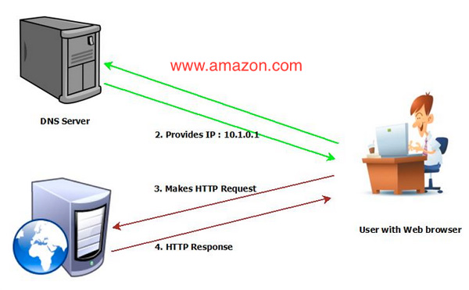
DOMAIN NAME SYSTEM (DNS)
The Domain Name System (DNS) is one of the foundations of the internet.
DNS is a directory of names that match with numbers

Slide 20

Thank you

